Slide 1
Waterways Council, Inc.
Tracy Zea, President/CEO
Rail Supply Chain Summit
10-15-20

Slide 3
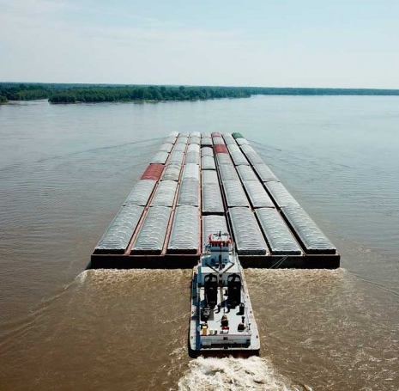
Key Facts About the Inland Waterways System
Over 25,000 miles of navigable waterways
Directly impacting 38 states
Over 578 million tons of cargo moved yearly with an economic value of over $232 billion
Some of the commodities moved include:
Fertilizer
Petroleum
Coal
Grain
Steel

Slide 4
Nashville petroleum Trend
Gasoline and Ethanol
 | CY 2014 | CY 2015 | CY 2016 | CY 2017 | CY 2018 | CY 2019
Middle TN Market Share by Barge | <2% | 2-10% | 10-20% | >25% | >40% | >45%
Diesel
 | CY 2014 | CY 2015 | CY 2016 | CY 2017 | CY 2018 | CY 2019
Middle TN Tons by Barge | <150K tons | <150K tons | >250K tons | >450K tons | >600K tons | >500K tons
Source: Corps of Engineers Lock Performance Monitoring System

Slide 5
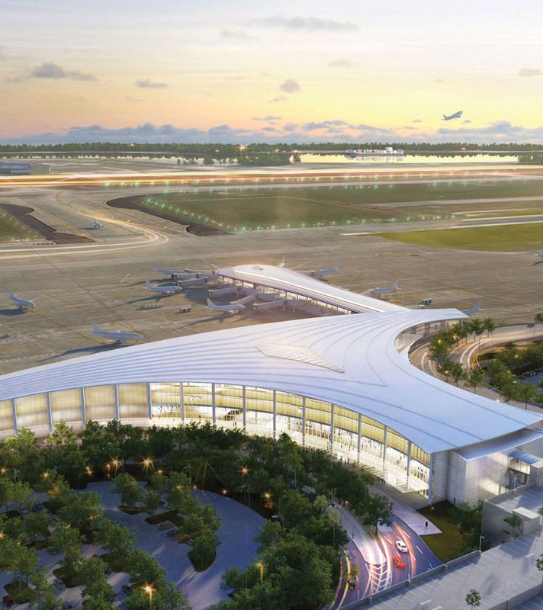
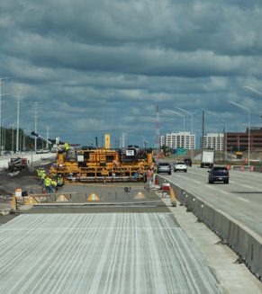
Projects Sourced via Barge

Slide 6
America’s Waterways: A Great Success Story
Attracts billions of dollars of investment in landside plants and equipment
Creates and supports millions of family-wage jobs
A critical energy supply line
Helps to keep U.S. industries competitive in a global market
Facilitates exports
Is environmentally sensitive, reduces pollution, saves fuel

Slide 7
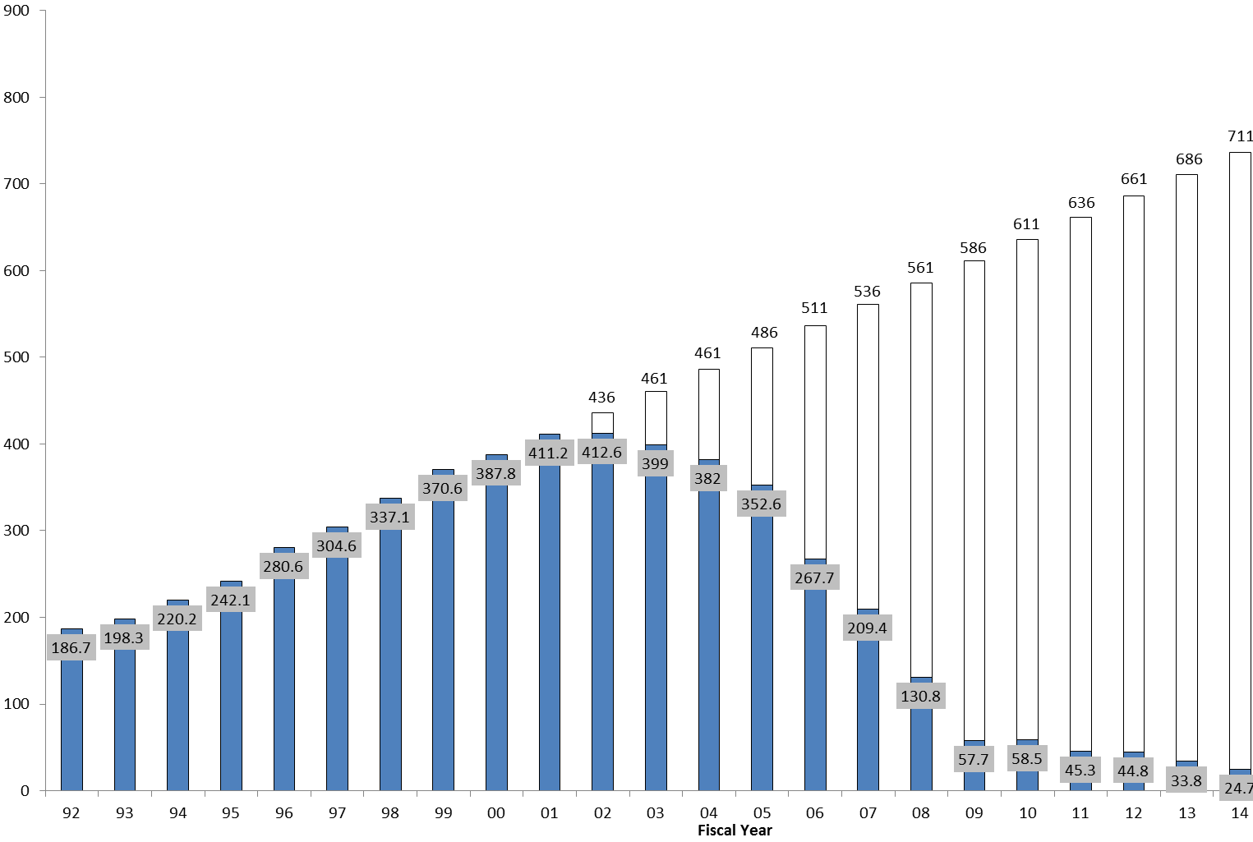
Inland Waterways Trust Fund Year-End Balances 1992 - 2002

Slide 8
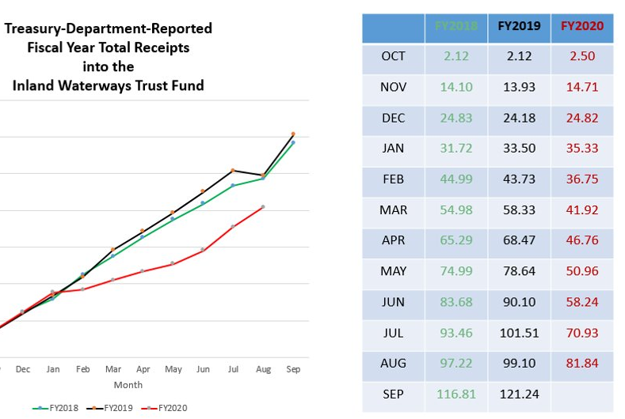
COVID-19 Impact on Inland Waterways

Slide 9
WCI’s Advocacy Efforts
Broad stakeholder support
Advocacy before Congress and the Executive Branch
Targeted media and public relations program

Slide 10
WCI Successes
Expenditure of the IWTF fund on modernization of the inland waterways system
Increased construction investments
Increased operations and maintenance investments
Olmsted Lock and Dam, Kentucky Lock and Dam, and Chickamauga Lock and Dam
Improved, more positive media coverage and better understanding of value of inland waterways system.

Slide 11
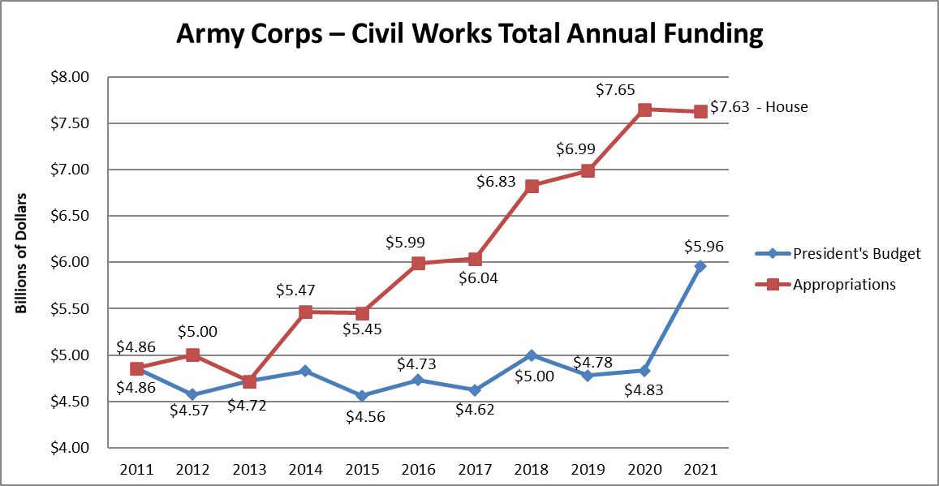
Notes:
TOTAL CW funding levels
Harbor Maintenance Trust Fund (HMTF) projects receive $1.68 billion, $50 million above the FY20 level and an increase of $665 million above the Administration’s request. This represents 92% of estimated HMTF revenue, an increase of 9% above the target set by the Water Resources Reform and Development Act (WRRDA) of 2014.
The Subcommittee did not yet release information on the number for Inland Waterways Trust Fund Construction and Major Rehabilitation projects. We will have this information when the full Committee marks the bill up.
The House bill also provides for seven new study starts and seven new construction projects to be selected by the Administration.
In addition, the Corps of Engineers will receive an additional $17 billion in emergency funding to accelerate work on Corps projects. Of the additional $17 billion, the Construction account will receive $10 billion to accelerate projects across all Corps mission areas, at least $3 billion of which is for inland waterways projects.

Slide 12
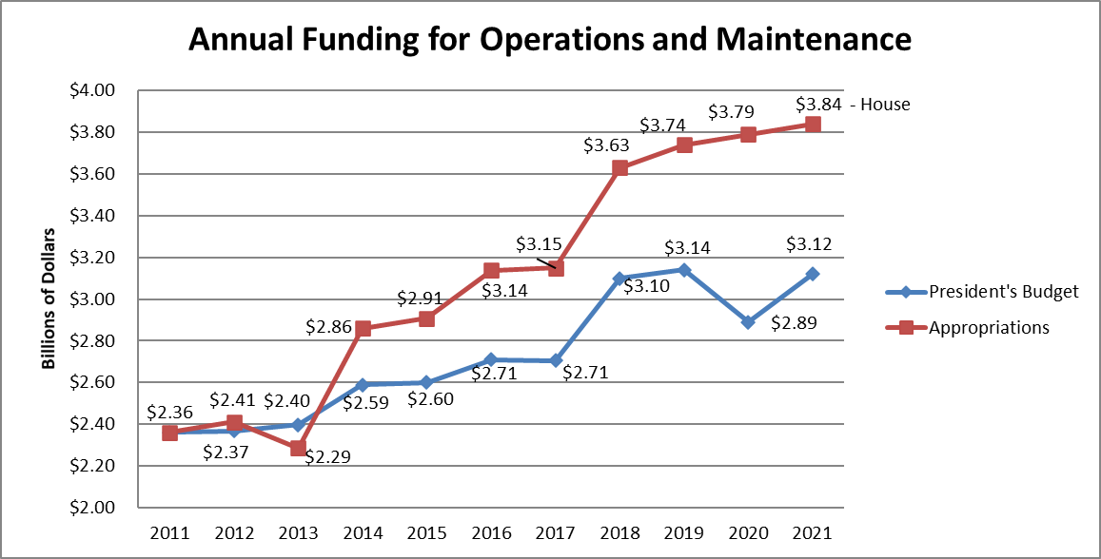
Notes:
Funding for Operations and Maintenance (O&M) is $3.84 billion, an increase of $48 million above FY20 and $1.8 billion above the Administration request.

Slide 13
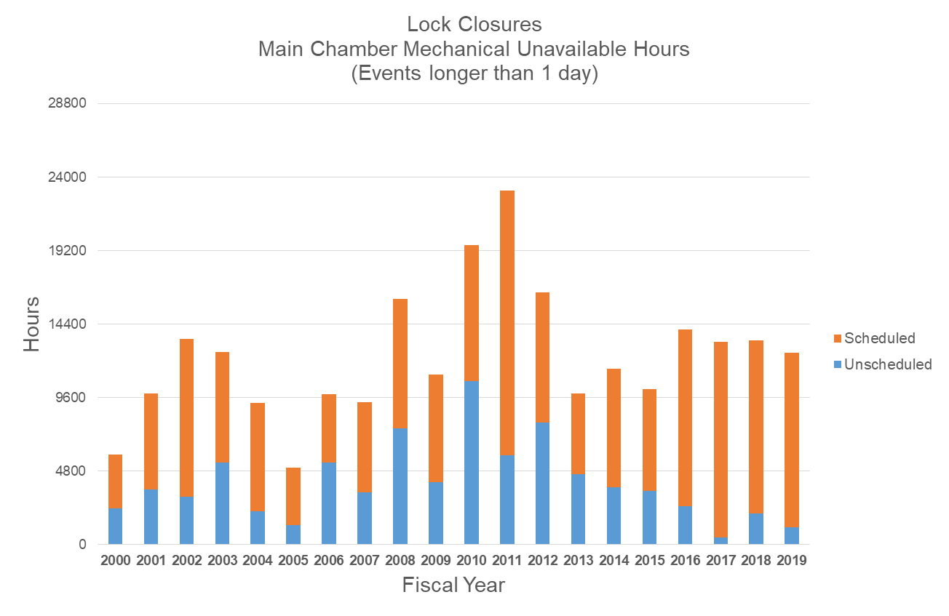
National Lock Portfolio Service Trends Main Chamber Mechanical Unavailable Hours (Events Longer than 1 Day)
Notes:
But the better news is that the number of unscheduled emergency outages has been going down significantly, thanks to additional Operations & Maintenance funding that has been flowing to the Corps, and of course to the Corps’ good work in keeping the system performing well under duress. You will note that 2019 showed the slightest number of unscheduled outage hours since 2005.

Slide 14
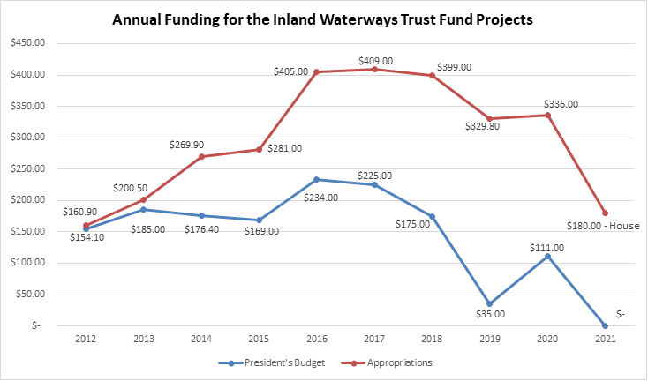
$0
Notes:
CONSTRUCTION: FY20 Lower Mon $111M, Chickamauga $94.5M, Kentucky $66.1M, Olmsted $35M = $306.6M efficient funding

Slide 15
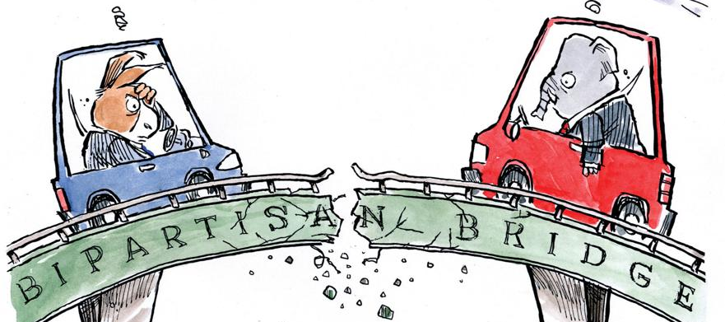
Infrastructure: A 2021 Stretch-Goal?

Slide 16
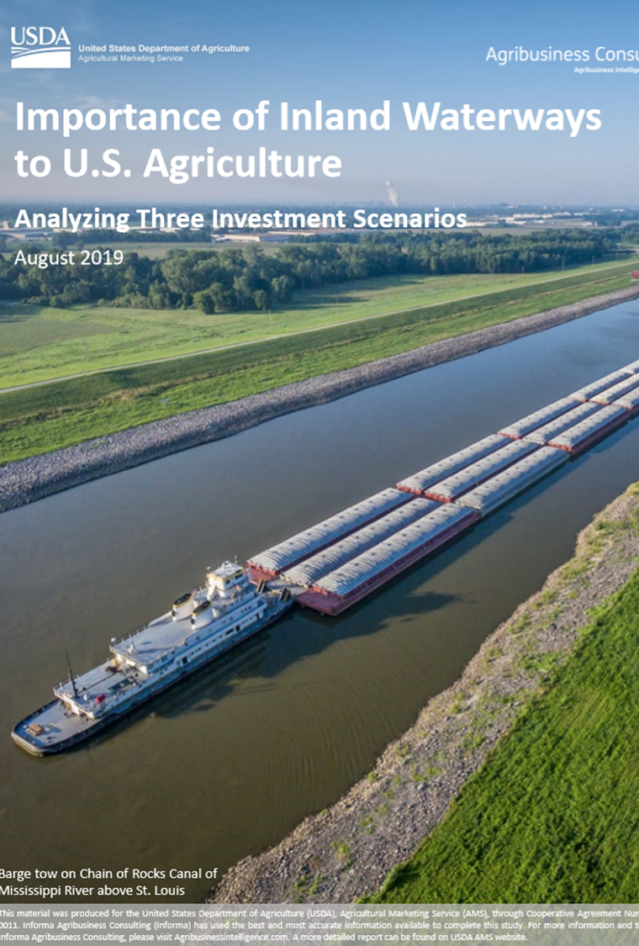
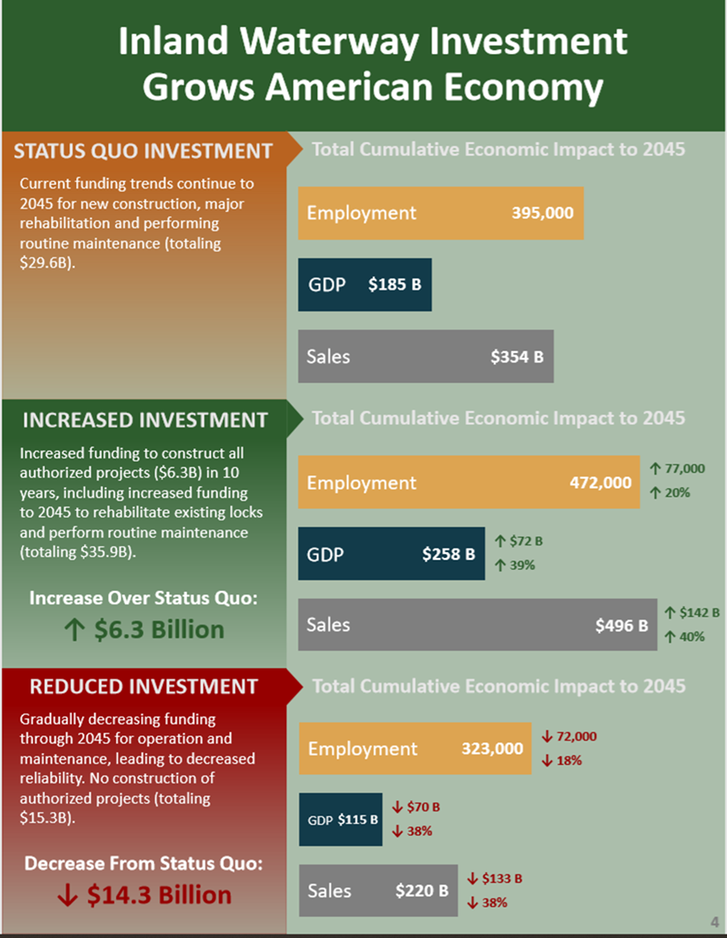
Notes:
Attn on Upper Miss, IL Rivers- Aug 2019 USDA study, Sec Purdue outreach to ASACW RD James, in FY2020 workplan, LaGrange rehab start

Slide 17
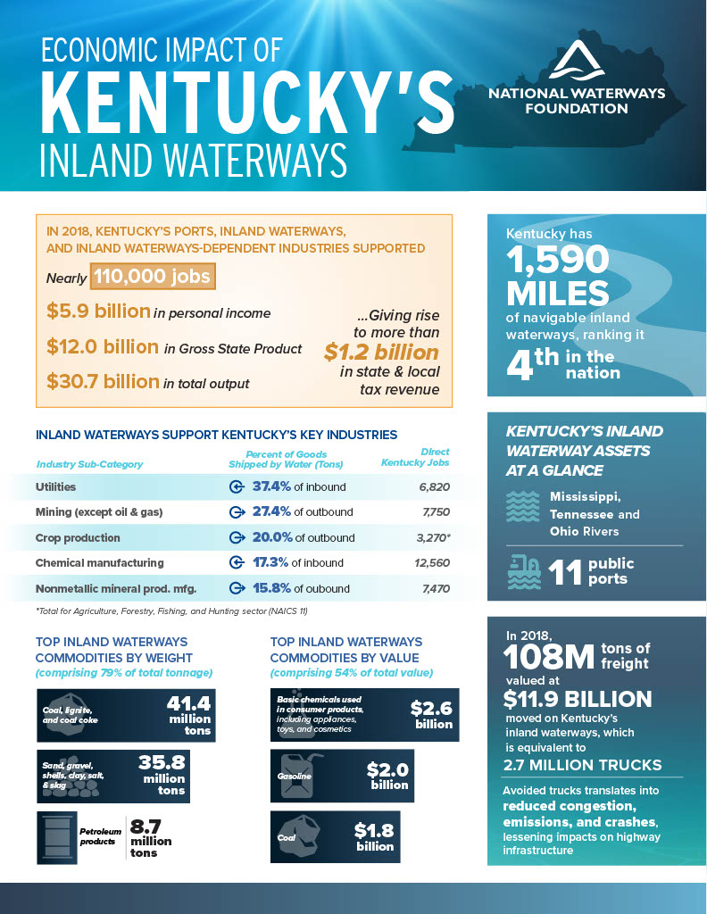
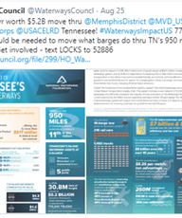
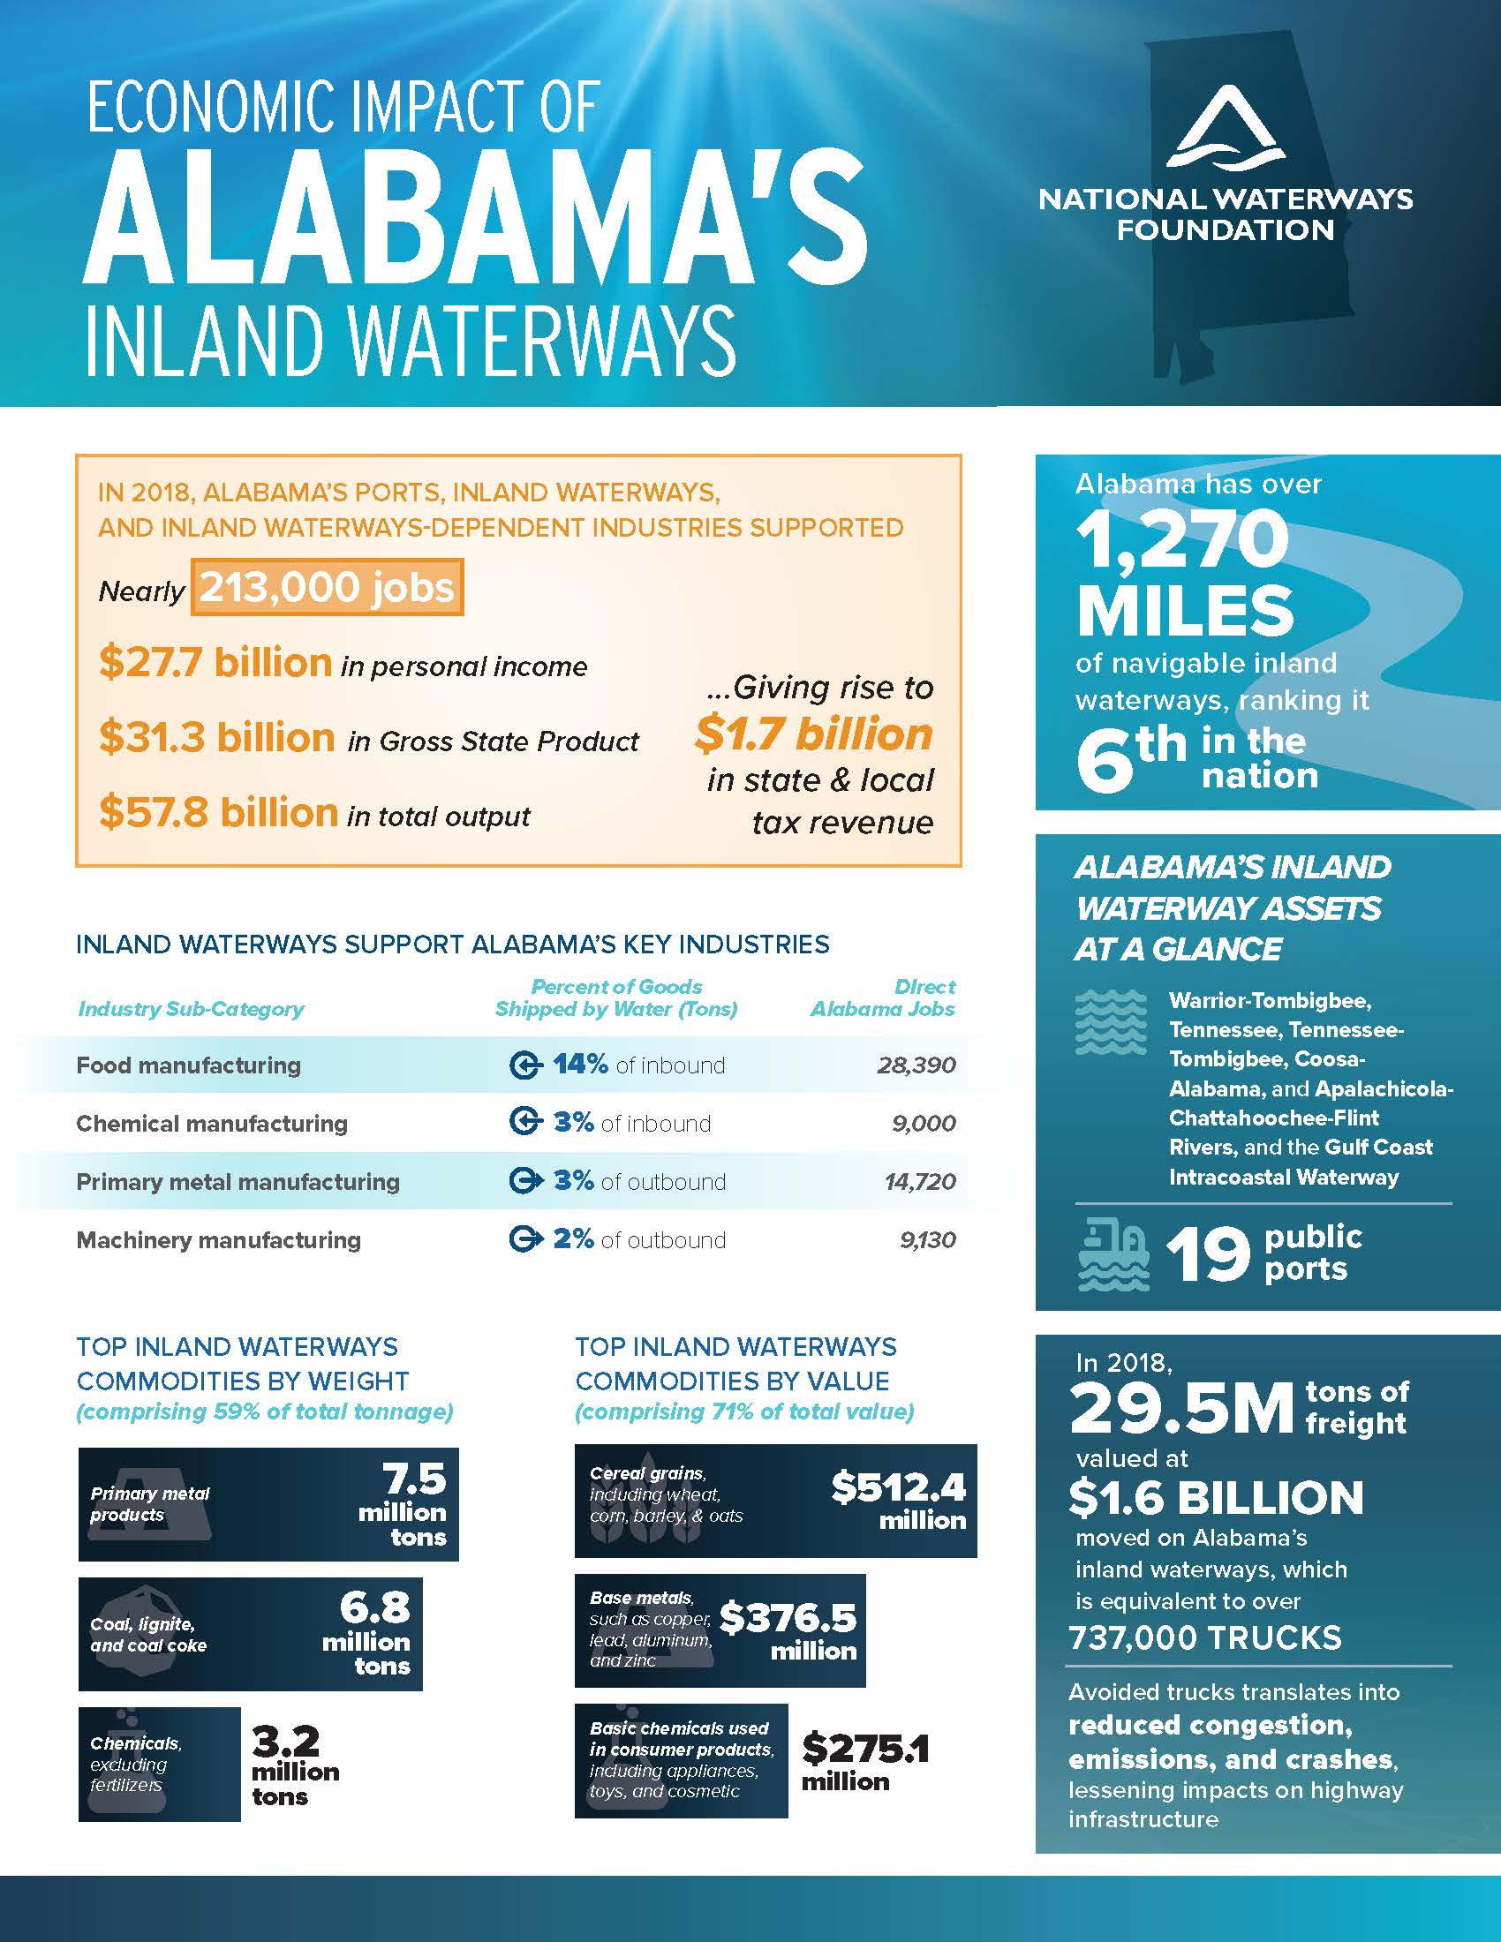
New Educational Resource:
State Waterways Profiles
New Resource: State waterways profiles

Slide 19
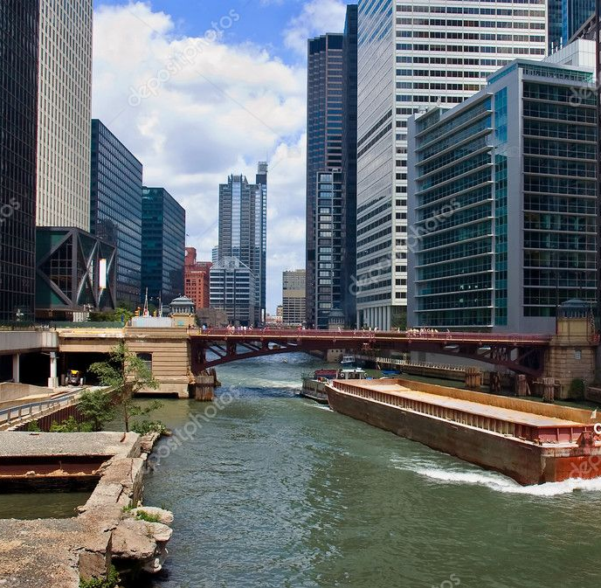
Questions?
Tracy Zea
202-765-2114
tzea@waterwaysconcil.org

