Slide 1
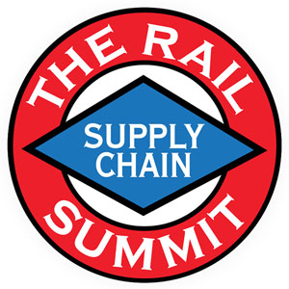
The Continuing Economic Importance
of the Inland Waterways
Merritt Lane
President and CEO
Canal Barge Company, Inc.
October 15, 2020

Slide 2
Topics
Inland marine transportation value proposition;
Canal Barge Company – history and capabilities;
Brief thoughts on possible paths to greater cooperation between rail and barge;
Update on the Illinois River closure for lock rehabilitation projects.

Slide 3
U.S. Inland Waterway System
Vital part of the U.S. transportation infrastructure.
Barge transportation:
Has significant capacity to move tonnage;
Provides water-served customers safe, reliable, cost-effective, flexible service;
Adds resiliency and environmental sustainability to shipper supply chains.

Slide 4
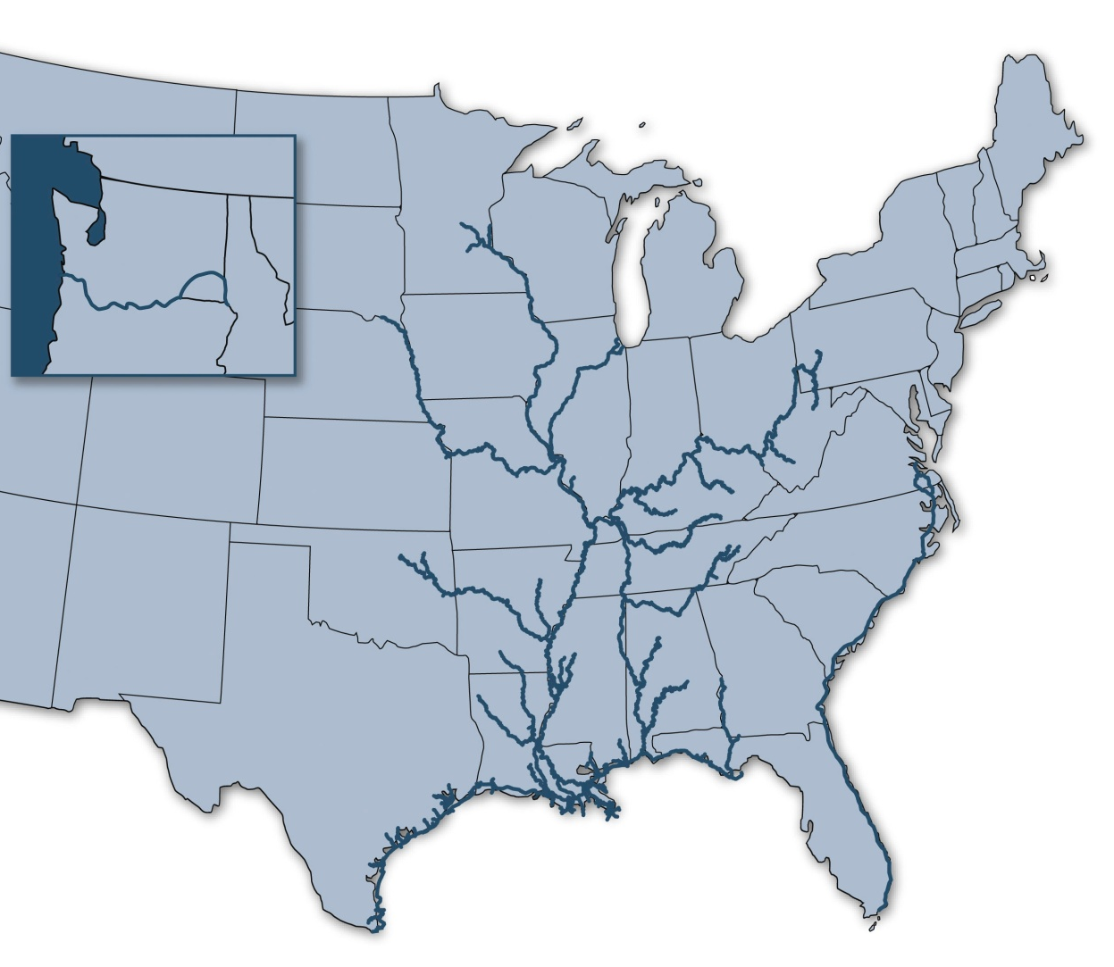
“Inland Marine Highway”
Over 25,000 miles of navigable waterways connecting 38 States
192 lock sites
578 million tons of cargo transit the inland waterways
More than 60% of the nation’s grain exports
About 22% of domestic petroleum products
20% of the coal used in electricity generation
14% of all intercity freight, valued at nearly $232 billion.
Minneapolis St. Paul
Portland
Chicago
Pittsburgh
St. Louis
Tulsa
Houston
Mobile
New Orleans
Corpus Christi
*updated with 2015 data

Slide 5
Advantages of Inland Waterways Transport:
Source: Texas Transportation Institute Center for Ports and Waterways, February 2017
Notes:
5
5
The TTI report also made a useful comparisons of cargo capacity relating it to measures that the public is more likely to understand.

Slide 6
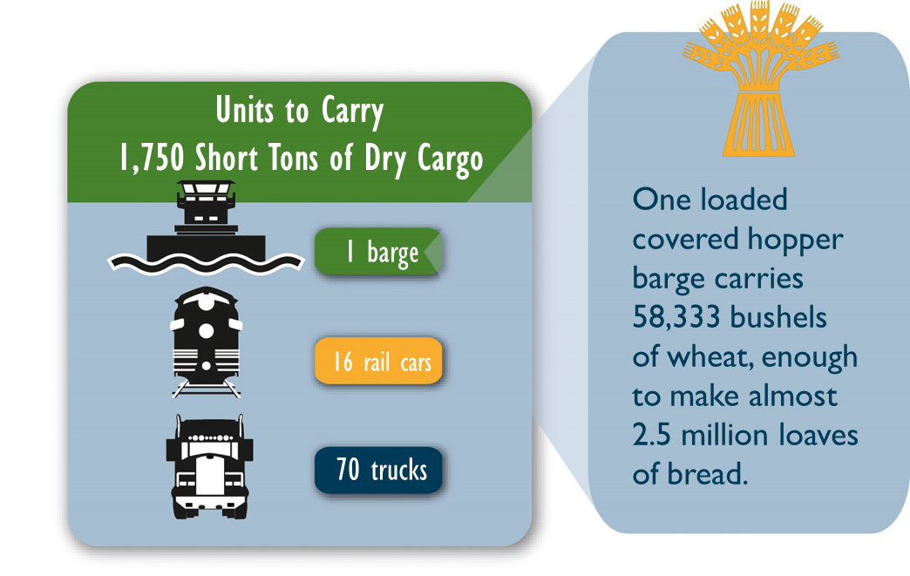
Advantages of Inland Waterways Transport:
Source: Texas Transportation Institute Center for Ports and Waterways, February 2017
Notes:
6
Similarly, the report pointed out that one barge load of wheat could produce 2 1/2 million loaves of bread. That’s nearly one loaf for every person – man, woman and child – in the state of Kansas!

Slide 7
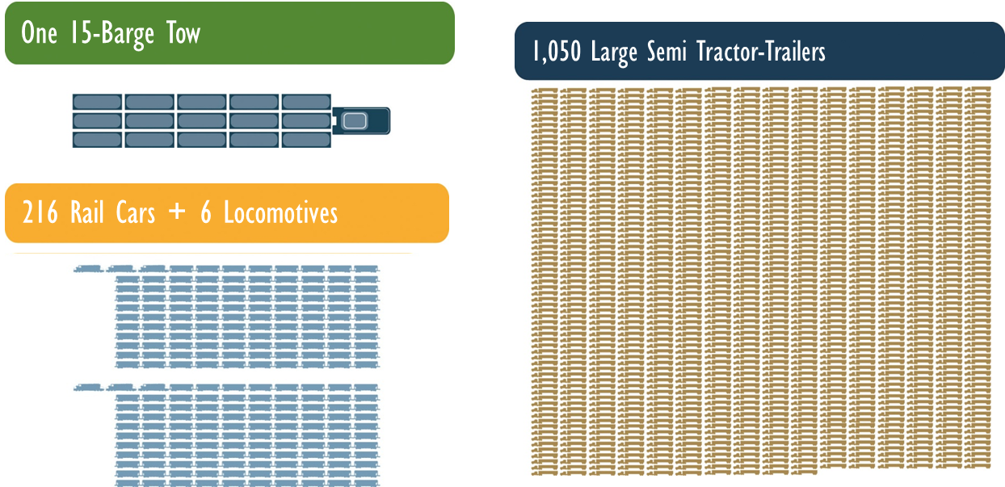
Dry Cargo Capacity
Source: Texas Transportation Institute Center for Ports and Waterways, February 2017
Notes:
7
7
The following slides come from a study commissioned by the National Waterways Foundation and prepared by the Texas Transportation Institute that reports on the effectiveness of barging relative to other modes of transportation. This slide relates barge capacity to other modes. As you can see a common 15-barge tow of dry cargo has the equivalent capacity of 216 rail cars and six locomotives, or 1,050 tractor-trailers.

Slide 8
Fuel Efficiency
647
477
145
Ton-miles Traveled per Gallon of Fuel
Source: Texas Transportation Institute Center for Ports and Waterways, February 2017
Notes:
8
How many of you have seen the railroads advertisements regarding the relative fuel efficiency of rail to truck? Well, we’re better!

Slide 9
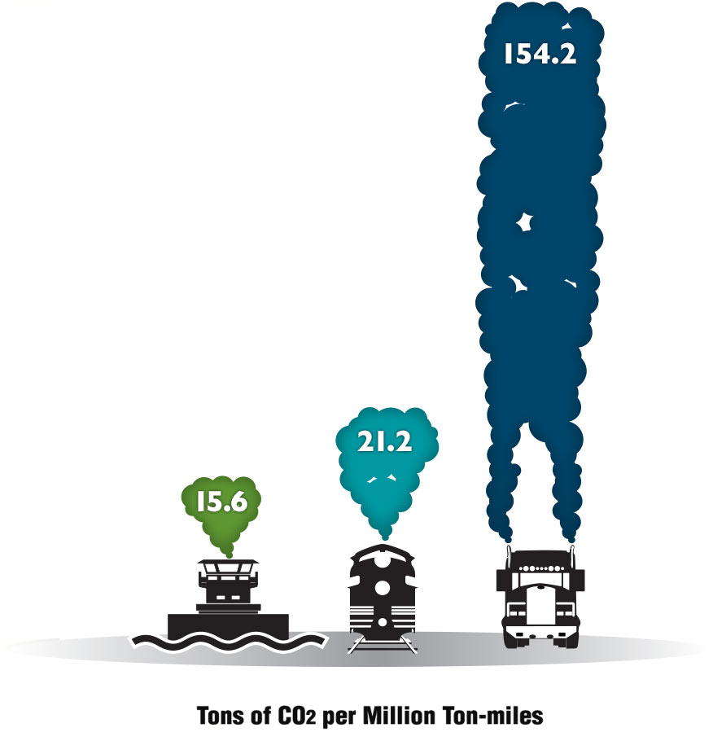
Cleaner Air Today is the Foundation for a Brighter Future
One of the many ways that waterways keep Americans healthy is by reducing emissions of carbon dioxide and other pollutants
Railway transport generates 30% more carbon dioxide than barge transport.
Highway transport generates 1000% more emissions than barge transport.
Source: Texas Transportation Institute Center for Ports and Waterways, February 2017
Notes:
And, we are greener than truck or rail!
9

Slide 10
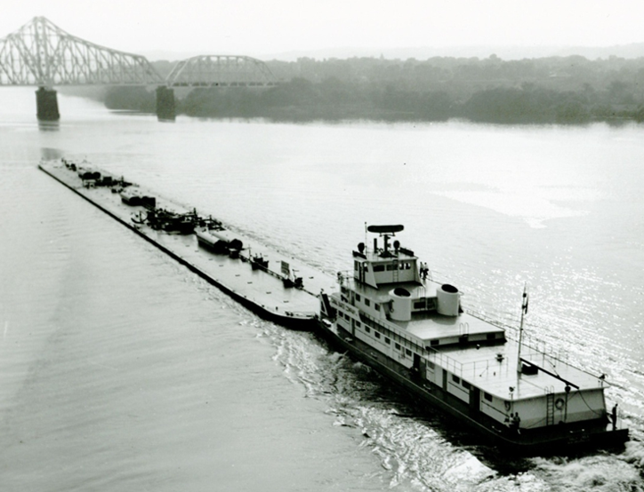
Canal Barge Company: A Tech Start-Up
1933 – Pioneering entrepreneurs who believed in waterborne commerce.
First all-welded steel tank barge complete with an onboard pumping unit to haul fuel along the Gulf Intracoastal Canal… thus the name.
Over the next 50 years, CBC was a leading innovator in equipment and systems design and became known for its integrity, customer service and expertise.

Slide 11
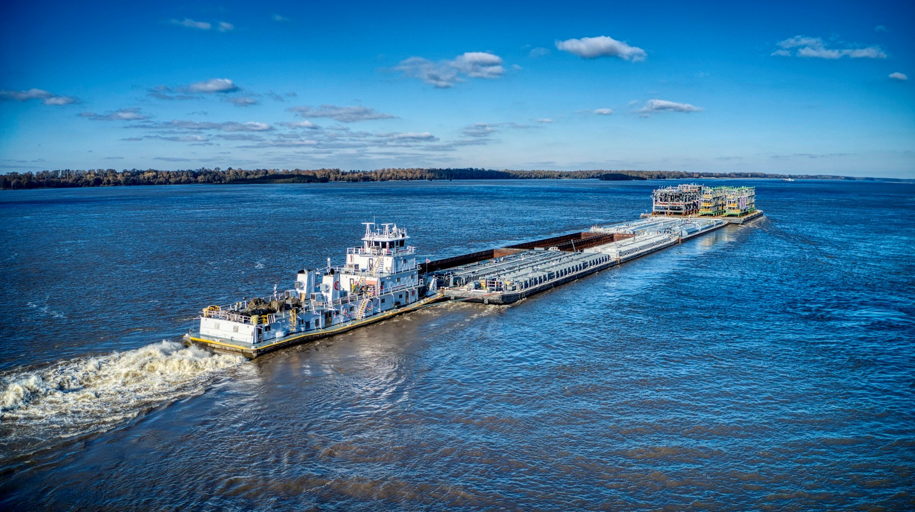
CBC: One of the Largest and Most Diverse Privately -Owned Marine Transportation Companies in the U.S.

Slide 12
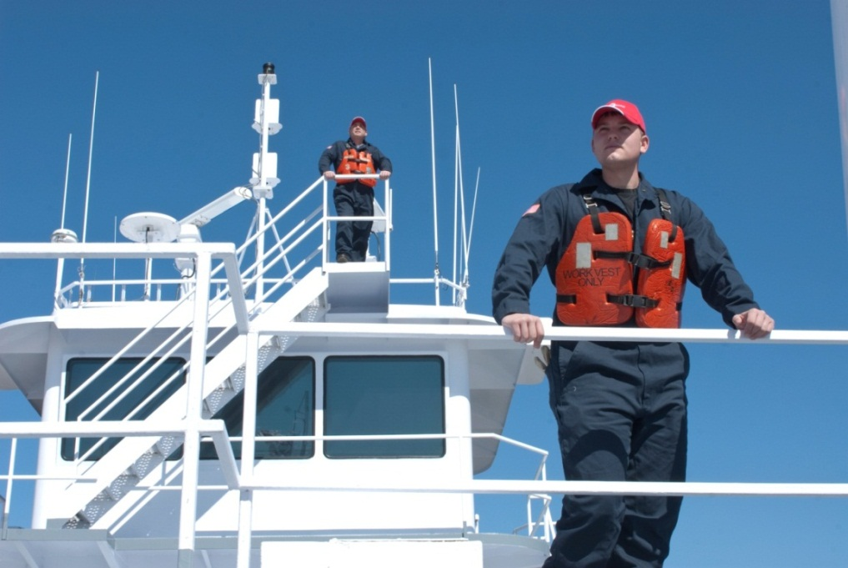
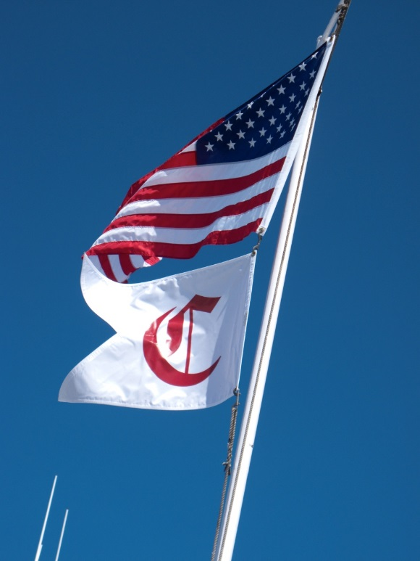
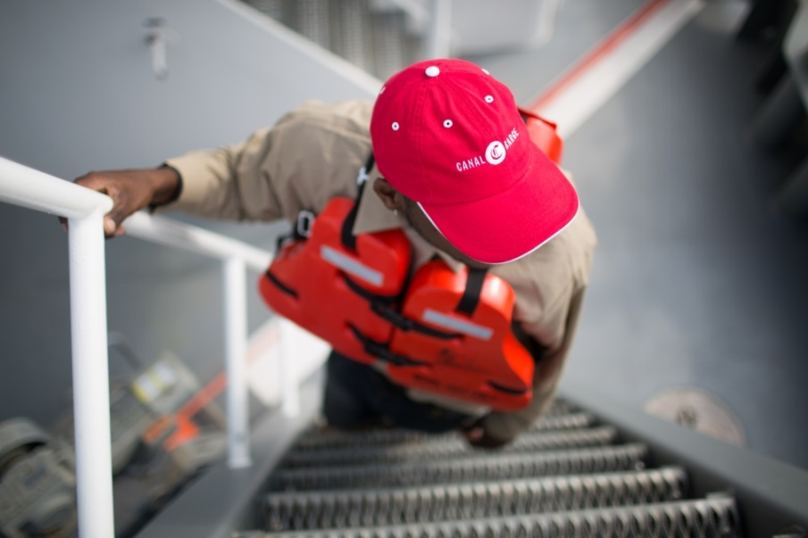
Canal Barge Company, Inc.
We concentrate on areas where specialized knowledge, equipment, focus, and people make a difference. We are a transportation and logistics solutions company.
Strong Culture and Strong Balance Sheet…Move With Confidence.
Notes:
12
CBC was founded in 1933 with 1 tank barge, the CBC-1. The name ‘Canal Barge’ comes from the area of operation in the early years when we primarily moved gasoline along the canal system in New Orleans. As we have grown, we continue to focus on areas that our people can truly make a difference.

Slide 13
Safety First: Because we have the Courage to Care!

Slide 14
CBC Core Belief
Successful, continuous, trusting relationships create lasting value:
For our customers;
For our employees;
For our vendors;
For our communities;
For our shareholders.
Notes:
We think successful relations create lasting value

Slide 15
Mission Statement
Form long-term mutually profitable partnerships with our customers
by providing consistently high quality marine transportation, harbor services,
bulk liquid storage handling, and management services, with zero spills and incidents.
Vision Statement
To be the best-in-class provider of logistics solutions and a preferred partner
to our customers, vendors, and employees.

Slide 16
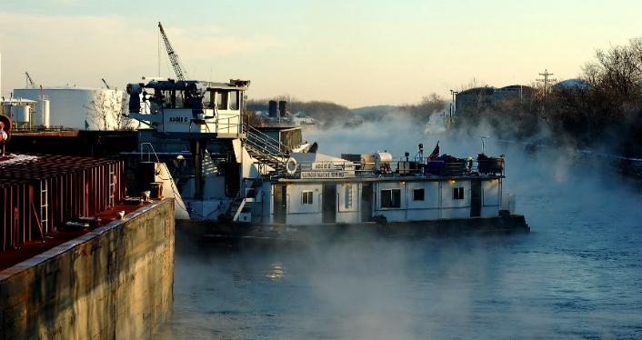
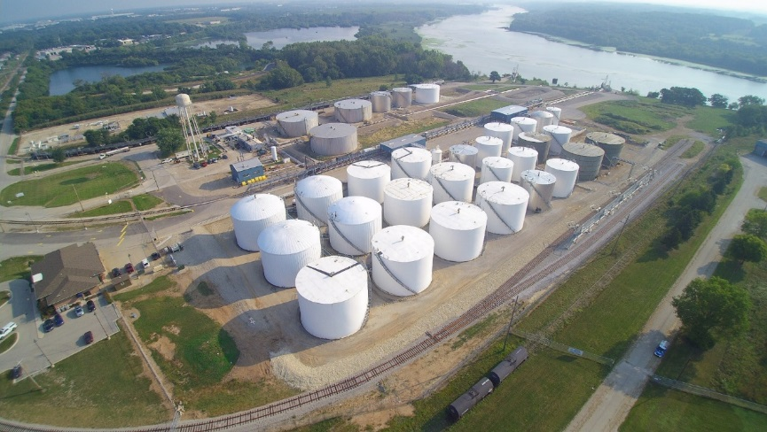
“Smart Diversification”
Canal Analytical & Environmental Services
Liquid Cargo Services
Illinois Marine Towing
Deck Cargo Services
Canal Terminal Company
Pelican Marine Services
Dry Cargo Services

Slide 17
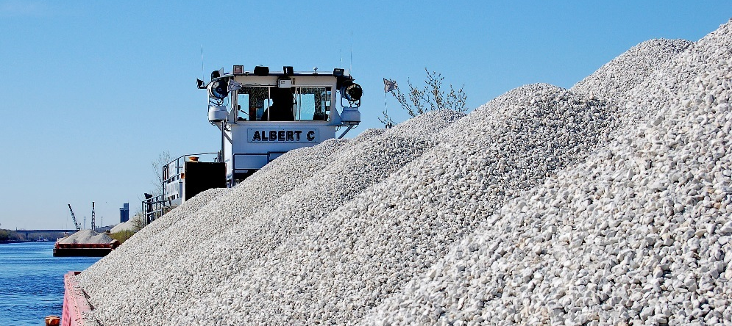
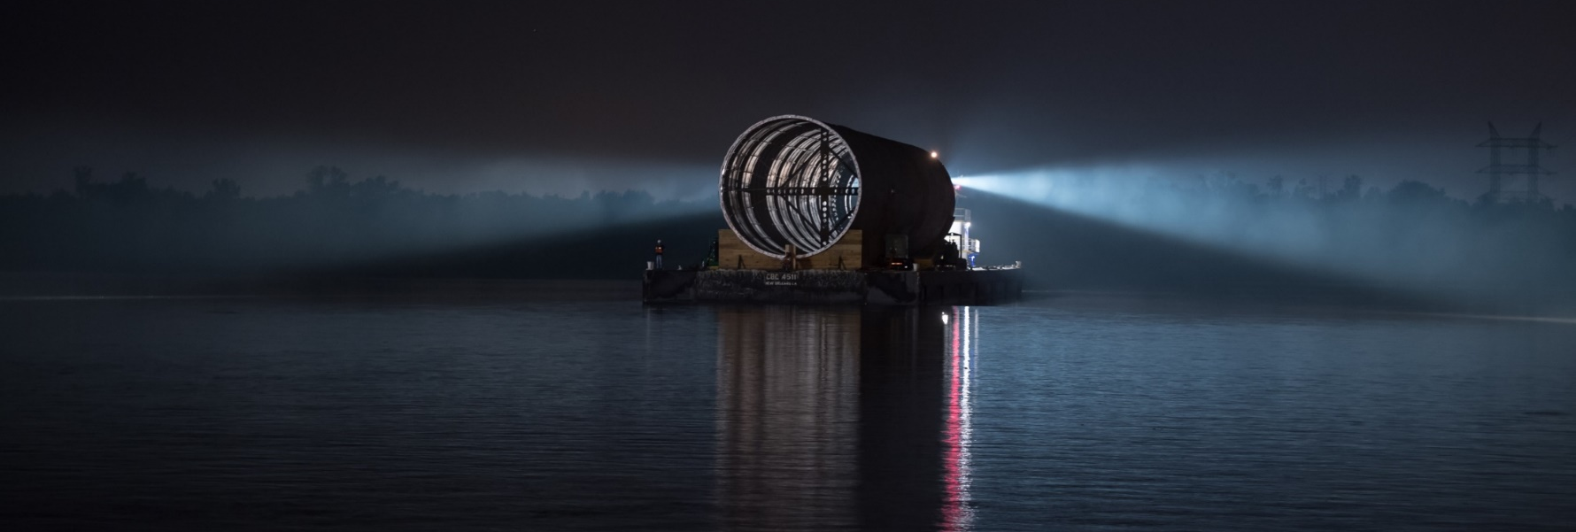
What We Move From Basic Materials to Space Age Material
Lube oil and antifreeze to distribution centers for automotive industry
Chemicals to manufacturing facilities
Asphalt to road pavers
Petroleum coke for fuel sources
Coal to power plants
Limestone used as construction aggregate
Major components for oil and gas exploration as well as for heavy industrial manufacturers, refiners and utilities
Military equipment for training exercises
NASA’s preferred barge line

Slide 18
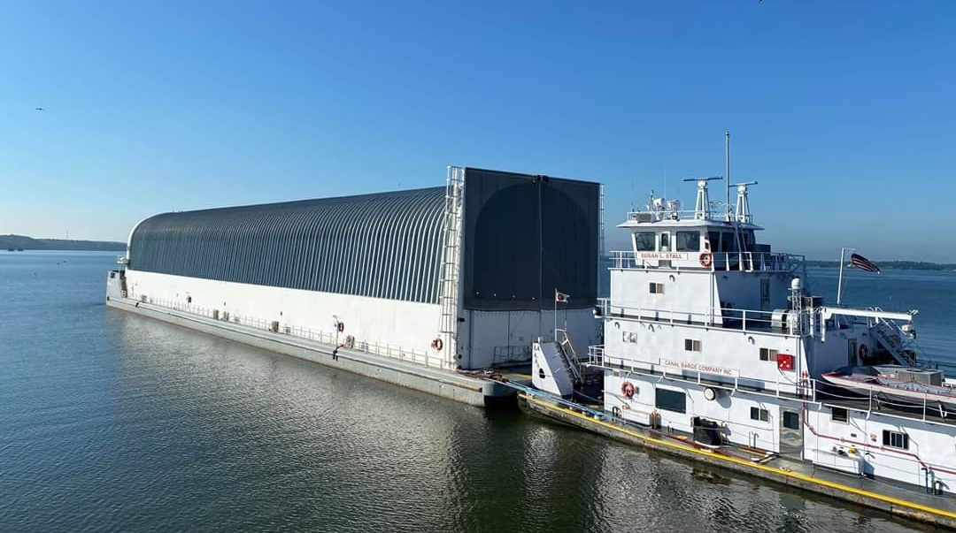

Slide 19
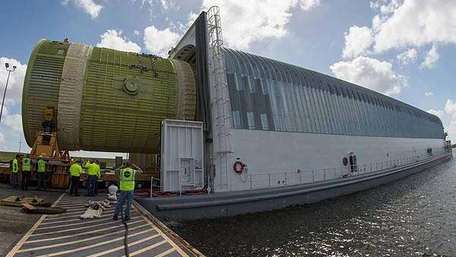

Slide 20
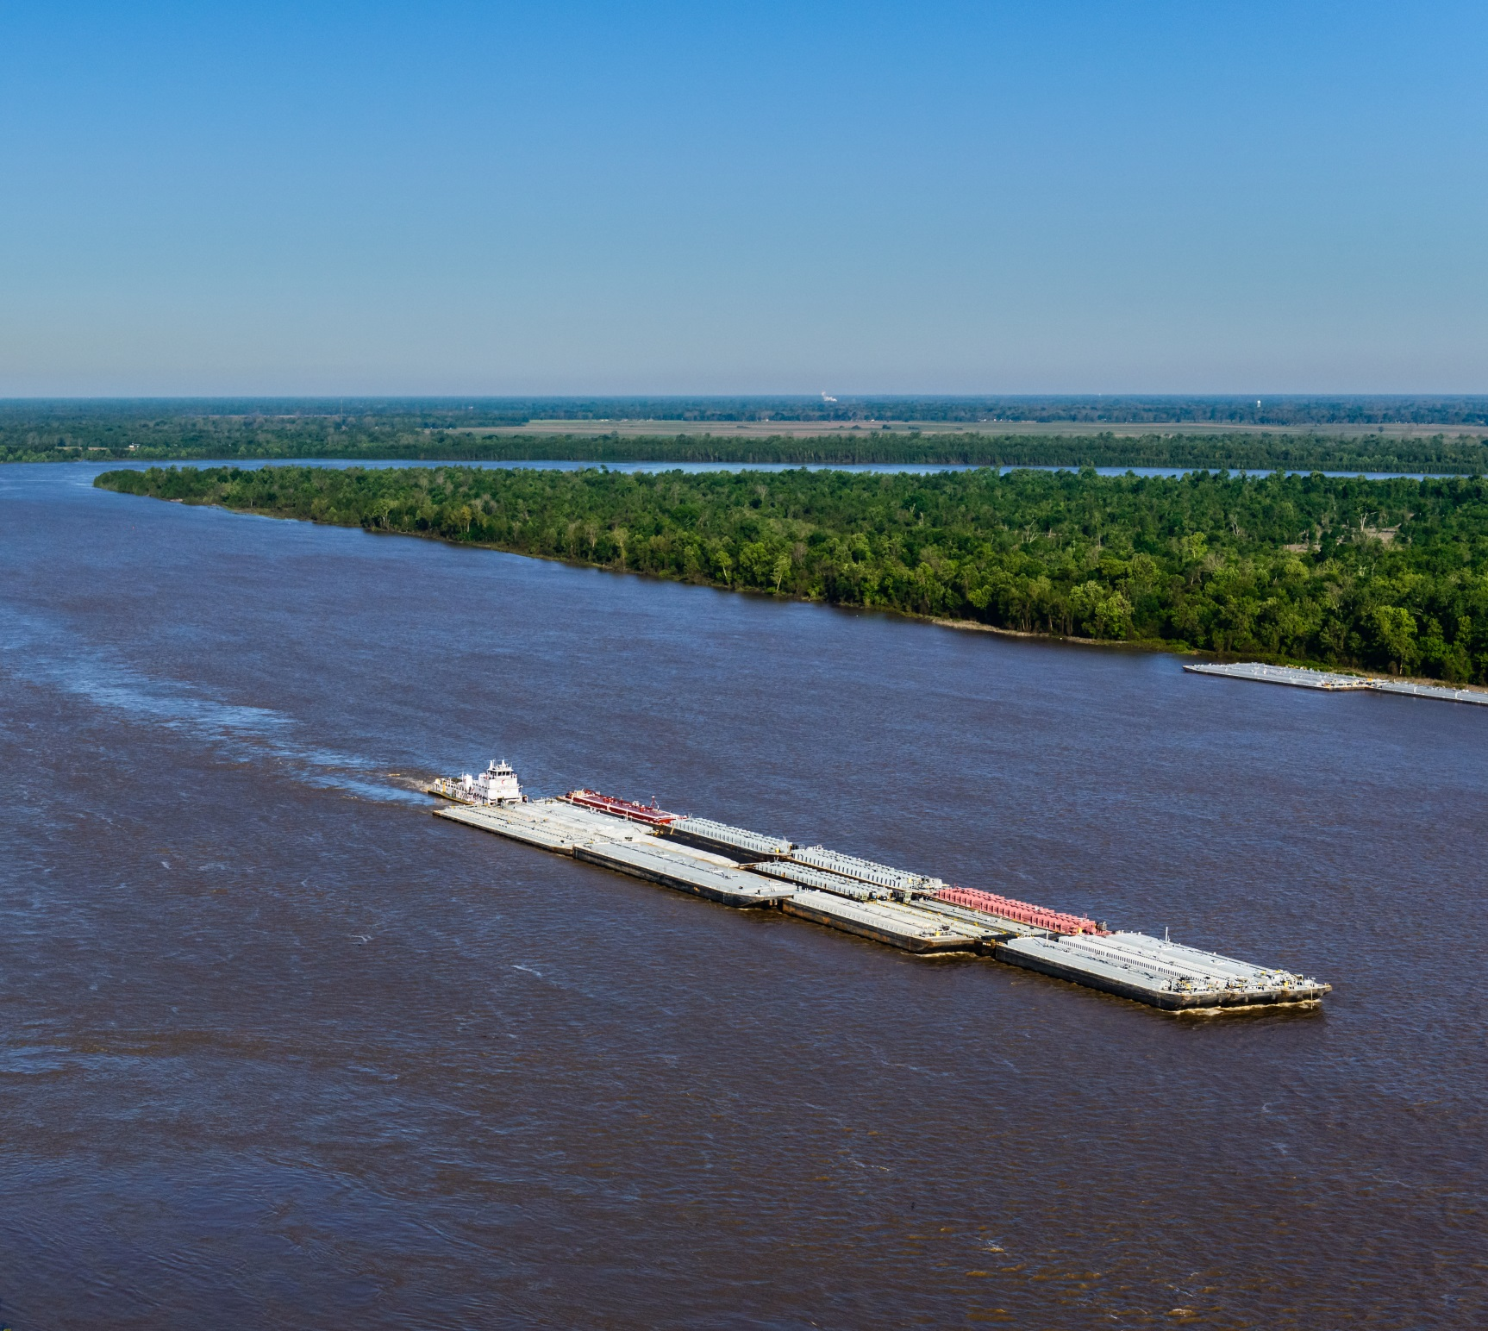
Liquid Cargo Services
Transportation of petrochemicals and oil products along the U.S. Inland Waterways.
One of the fastest-growing tank barge companies
3rd largest fleet for hire in the U.S.
Modern and diverse fleet
Diversified, balanced operations
Black oil/asphalt
Chemicals
Lube oils
Foodgrade & renewables
Notes:
Liquid cargo services is our primary business line and constitutes the 3rd largest tank barge fleet in the US. Combined with our growing towboat fleet, we are a dominant cargo carrier from the Gulf Coast to Midwest markets.

Slide 21
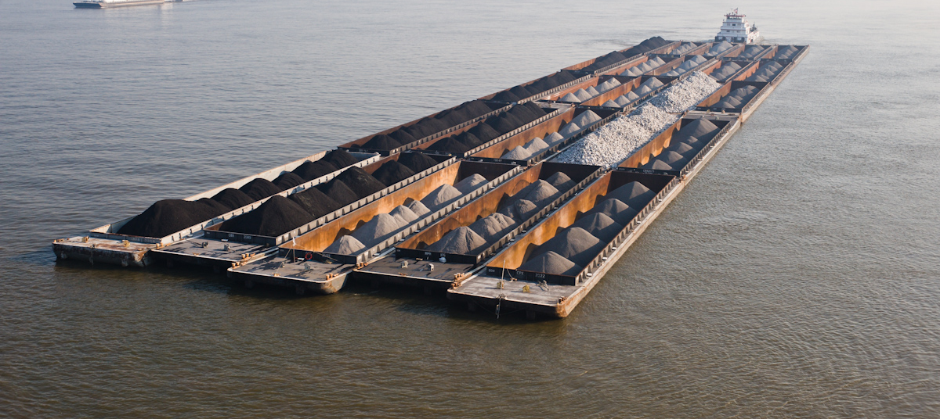
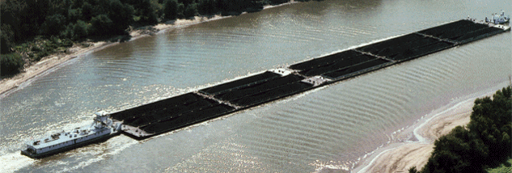
Dry Cargo Services
Logistics services for dry cargo shippers along the U.S. Inland Waterways.
Targeted customer base where CBC is uniquely positioned to provide solutions:
Strategic partner to refineries
Closed systems delivering utility coal
One of the largest delivery systems for construction aggregates to the Lower Miss
Integration with liquid towing system
All of these require a strong focus on operational excellence and quality service.
Notes:
21
Our dry cargo business line moves coal, rock and petroleum coke primarily along the Mississippi, Ohio, Tennessee and Cumberland Rivers. We typically seek long-term contracts to ensure the most efficient system.

Slide 22
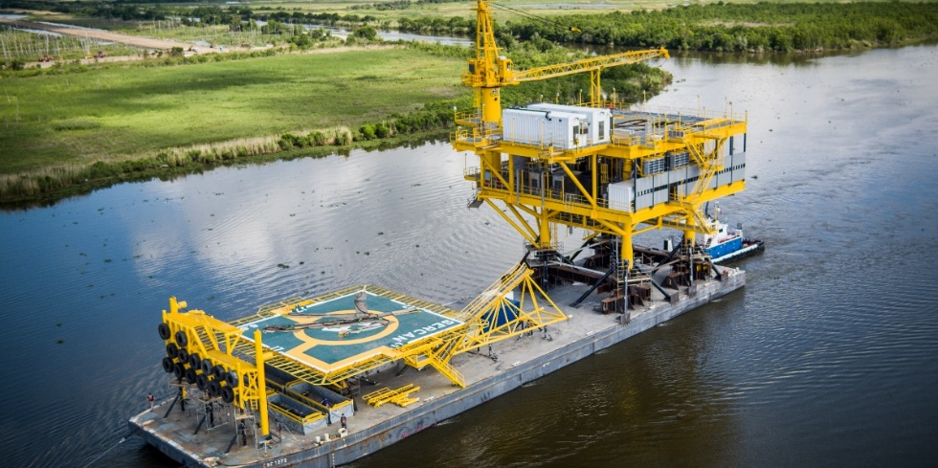
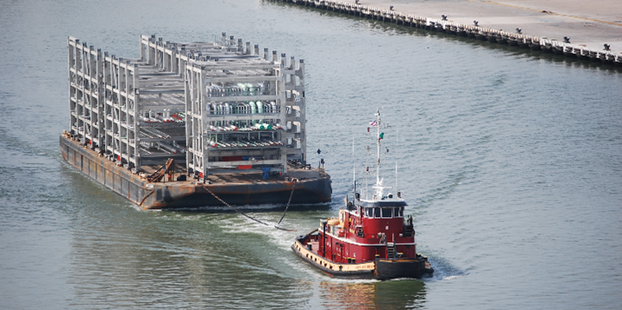
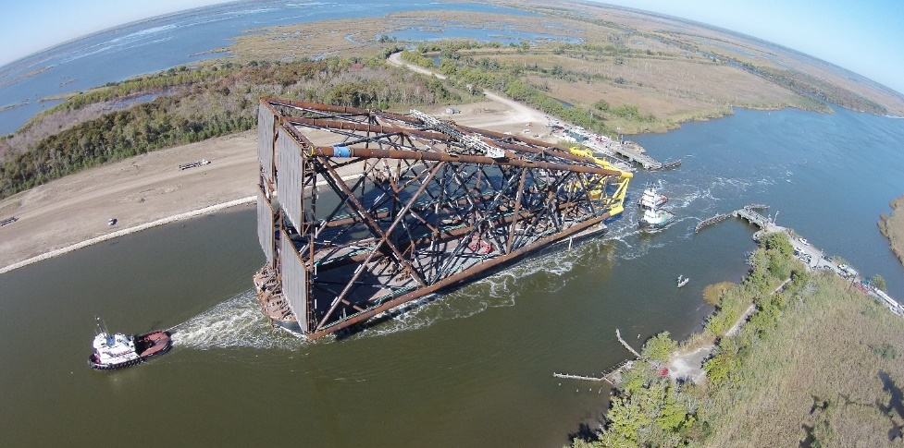
Project Cargo Services – Inland and Offshore
Customized logistical solutions from barge rental to turn-key projects to transport project cargoes to domestic and international ports.
Leading Jones Act Project Specialist
Modern deck barge fleet
Marine Transportation Solutions
Experienced Project Management Team

Slide 23
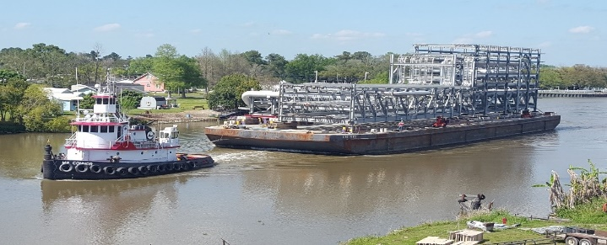
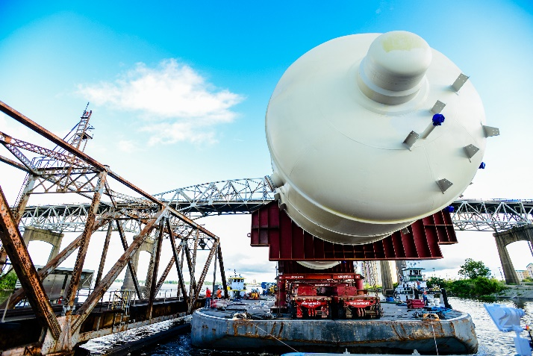
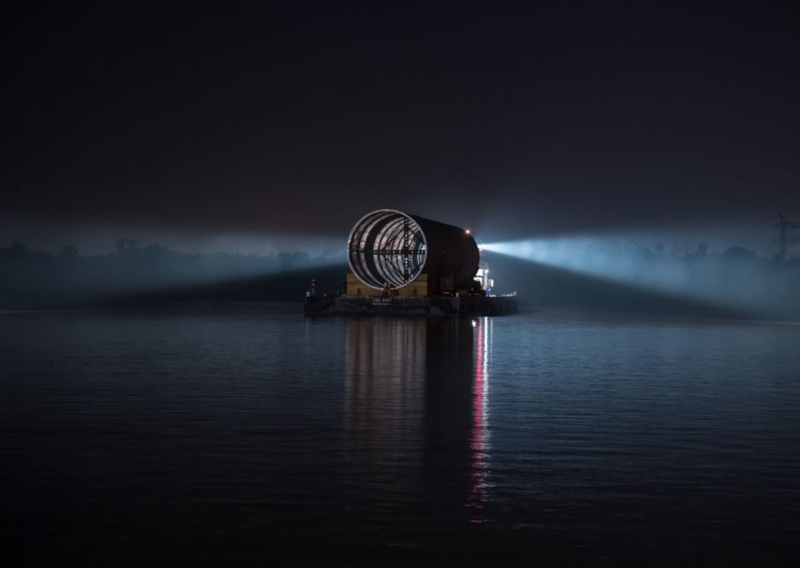
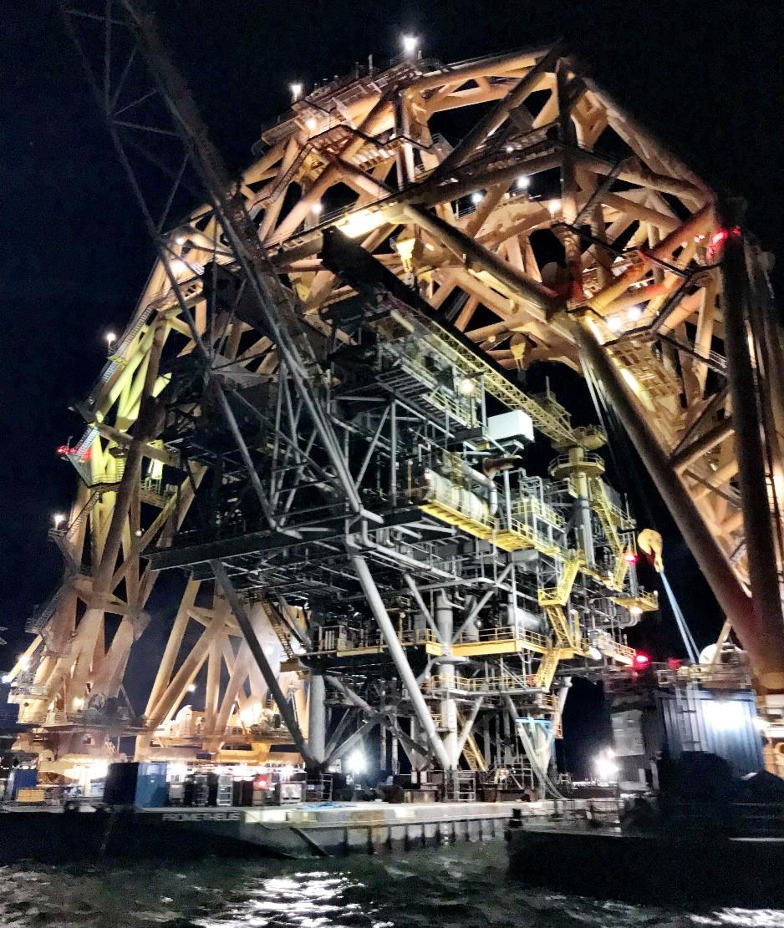

Slide 24
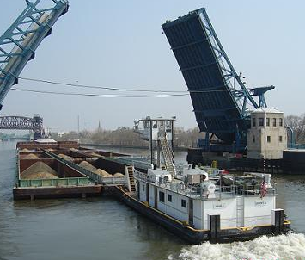
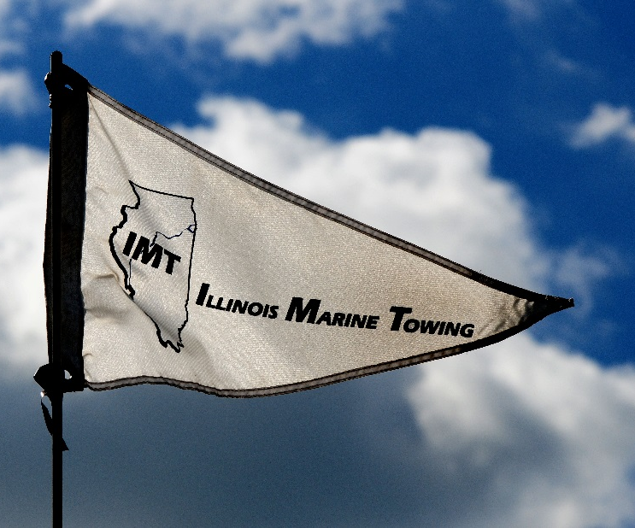
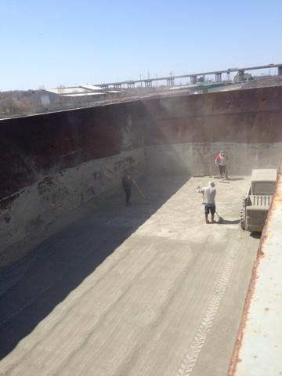
Illinois Marine Towing, Inc.
Leading towing, fleeting & harbor services company on the Upper Illinois River
Lemont Shipyard – Full shipyard repair services with dry-dock and barge cleaning services
Wholly owned Canal Barge Company subsidiary

Slide 25
Wholly-owned harbor services subsidiary in Houston Harbor benefiting our customers by providing quality control and greater efficiency.
Pelican Fleet
18 acres of submerged lands near Beltway 8 bridge
Capacity for 57 – 10,000 bbl barges
4 boats for fleet operations, shifting and standby
Pelican Marine Services
Base Oil Barge Cleaning, Vessel Services and Boat Dock
Almost 2 acres of land access

Slide 26
Liquid Storage Facility that sets the standard of excellence.
Almost 75-acre multimodal facility near Chicago, IL easily accessible by river, road or rail.
Less than 2 miles away from Interstates 55 and 80
7 rail sidings served by CSXT with rail storage
Located at mile point 28 on Illinois River with 3 barge docks
CTC has averaged approximately 3750 rail car moves annually for the last 3 years.
3rd-party bulk liquid storage and accessorial services
Customized solutions to logistics and project needs
36 Storage tanks with 30,710,400 gallons total capacity
Direct Transfer station
Truck scales
Video surveillance
Laboratory services
American Chemical Council – Responsible Care Approved
Notes:
Canal Terminal Company has provided another avenue of growth for CBC. Since the early ‘80s, we have grown from a simple asphalt terminal to a multi-product storage facility providing analytical and logistics services for chemical, oil, asphalt and sulphur customers.

Slide 27
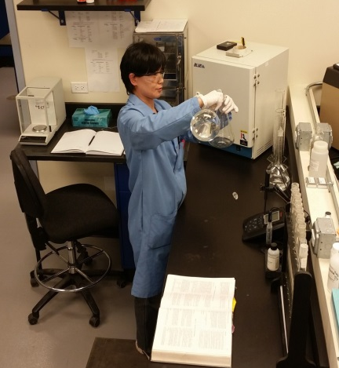
Quality testing services fully integrated into our service offerings at CTC.
Product quality testing for terminal customers
Regulatory testing for manufacturers, municipalities, truck washes
Sampling and analysis of:
Water – wastewater /monitoring wells
Soil – UST related
Sludge – landfills
Reporting – IEPA permit requirements
Consulting – Special Projects

Slide 28
Canal Barge Company Profile
People | 918
Barges | 918
Tank barges | 363
Deck barges | 148
Hopper barges | 407
CBC Towboats | 33
Pelican Marine Services
Approx. Fleet Capacity in Houston Harbor (CBC barges only) | 57
Pelican Marine Services Boats | 2
CBC North Facilities
Storage Tanks | 36
Total Storage Capacity (bbl) | 790,000
Rail Sidings at CTC | 7
Barge Docks at CTC | 4
Approx. Fleet Capacity along Illinois River (Regulation Barges) | 386
Syncrolift Drydock (2,200-ton Capacity) | 1
IMT Boats | 14
Data current as of September 11, 2020
Notes:
28
The MV Sidney Reese – Middle River Marine operated vessel for IMT is included as the 15th harbor boat – added to the fleet 3/2/17

Slide 29
CBC Inland Waterways System Map
IMT Shipyard
IMT Joliet Offices
CTC & CA&ES - Channahon
River Unit Tows
1 CBC boats
(working throughout Inland Waterways)
Illinois River & Chicago
15 IMT boats
River SIUT
Lower Mississippi & Illinois Rivers
9-10 CBC boats
Ohio River Towing Alliance
8 boats
Dry Cargo System
4 boats
CBC Field Operations Office – Sulphur
CBC Headquarters – New Orleans
CBC Operations Office – Belle Chasse
CBC Shore Tankerman
Office/Facilities
Pelican Fleet 4 boats | West Canal Gulf Unit Tows 11 CBC boats | Canal SIUT 8-9 boats
November 2019

Slide 30
We’ve come a long way!
Notes:
We have come a long way and now I am confident that we have the strongest talent, best fleet and best opportunity to differentiate from our competition….we are well positioned and we are not done yet!

Slide 31
Barge AND Rail
Major agricultural shipper:
We need both rail and barge transportation to handle our projected volumes.
We can maximize our thru-put managing rail and barge together (e.g. unloading rail cars between barge unloadings);
Perhaps rail and barge can work together to “increase the pie.”
Both are safer and greener than trucking.
Major liquid cargo shipper:
Barging might be complementary to precision scheduled railroading.
Reconsider interplay between rail and barge to identify the most efficient model to increase utilization of existing fleets.
Crude by rail as a proof point?

Slide 32
Illinois River Closure
The ILR Locks were constructed in the 1930s and are in desperate need of repair and rehabilitation.
Effective advocacy has resulted in increased funding for O&M and modernization.
The original plan was to close the locks in sequence over 4 consecutive years.
Industry prevailed on USACE to do all rehabilitation work in 2020 and then again in 2023.

Slide 33
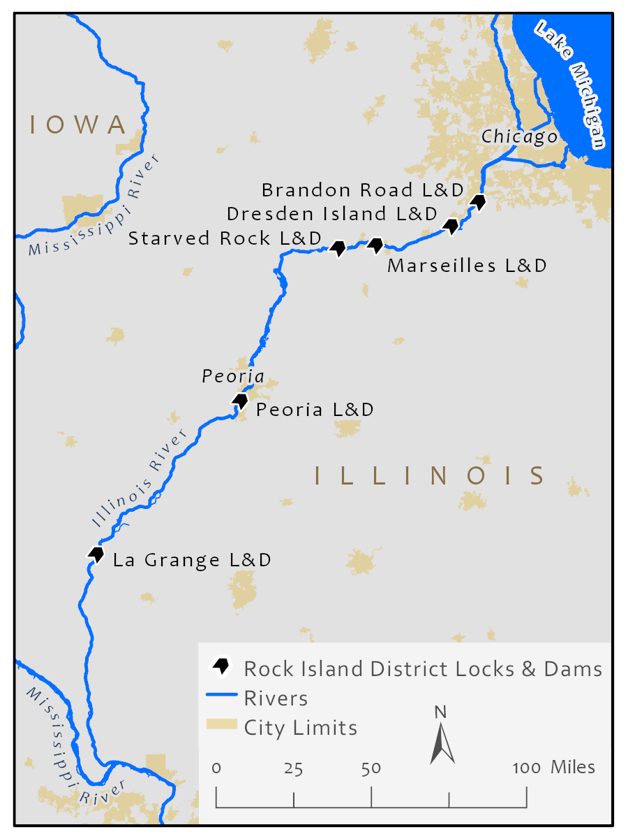
Illinois River 2020 Lock Closure Overview
The Illinois River is 327 miles long, from Grafton, IL to Lake Michigan near Chicago with 8 water controlling Locks and Dams. The four highlighted locks are scheduled to be completely closed to all navigation starting July 1st, 2020 for 120 days.
Chicago, Lake Michigan
Thomas J. Obrien L&D (326.0)
Lockport L&D (291)
Brandon Road L&D (286)
Dresden Island L&D (271.5)
Marseilles L&D (244.6)
Starved Rock L&D (231)
Peoria L&D (157.7)
Lagrange L&D (80.2)
Grafton, IL

Slide 34
CBC’s 120-120-120 Plan: Planning
CBC had both significant exposure as well as unique resources to utilize to meet the challenge of bringing customers’ solutions during the ILR closure.
Started planning 4Q 2018.
Determined that we would focus execution plan on what needs to happen 120 days prior to closing, 120 days during the closing and 120 days after reopening.
Engaged customers in earnest Summer 2019 – a full year before the closure.

Slide 35
CBC’s 120-120-120 Plan: Execution
We ultimately placed 80 CBC tank barges and 60 CBC open hoppers above the locks.
IMT has handled local shifts, readiness and shipyard requirements for CBC and other barge companies during the closure.
In addition:
We have used this downtime to accelerate maintenance on vessels.
We have committed to not have mariner layoffs or furloughs during this time.
Thus far the work has been done safely and without incident.
It appears that the Corps is essentially on track with the lock rehabilitation work and the river will reopen on time.
Barges are loading along the Gulf Coast and we are planning our sailing schedules to begin restocking and “winter fill”.

Slide 36
Thank You

